Slide 1
Building APIs in Government for Social Good
Tyrone Grandison PhD
www.tyronegrandison.org @tyrgr
Notes:
By show of hands,
How many people here have worked in Government?
How many people think that there is a technical difference between delivering APIs in Government vs the Private Sector?
My mission here today to shed some light on the process.
If there is anything that you need to remember from this talk, it is that there are more similarities than differences.

Slide 2
Deputy Chief Data Officer, US Department of Commerce (2015-16) White House Presidential Innovation Fellow, Department of Labor & US Census Bureau (2014-15)
My Time In Government
Notes:
I have spent the last two and a half years of my life working in government.

Slide 3

Notes:
Before government, I worked in the private sector, academia and startup world as a developer (Python, Java, C, C++), manager, CTO, Consultant and Founder, which gives me a unique perspective.

Slide 4
The Reality
APIs: Sweat and Toil, CitySDK, MIDAAS
Lessons
Notes:
This is the plan for today.
I am going to start with the reality of government, delve in three APIs that my teams and I have built, and finish with the lessons that we have learned.

Slide 5
government takes on the hardest, inelastic problems
Notes:
While the private sector takes on elastic problems, like entertainment and marketing.
Government takes on hard, inelastic problems like homelessness, health, safety, defense, trade, and social justice.

Slide 6
optimum
Notes:
The problems are difficult optimization problems
And not just in one dimension.

Slide 7
n-dimensional
Notes:
But rather in multiple dimensions
And many of the dimensions are not anywhere technology or science related.
*** Laws, Systems, Personalities/Egos.

Slide 8
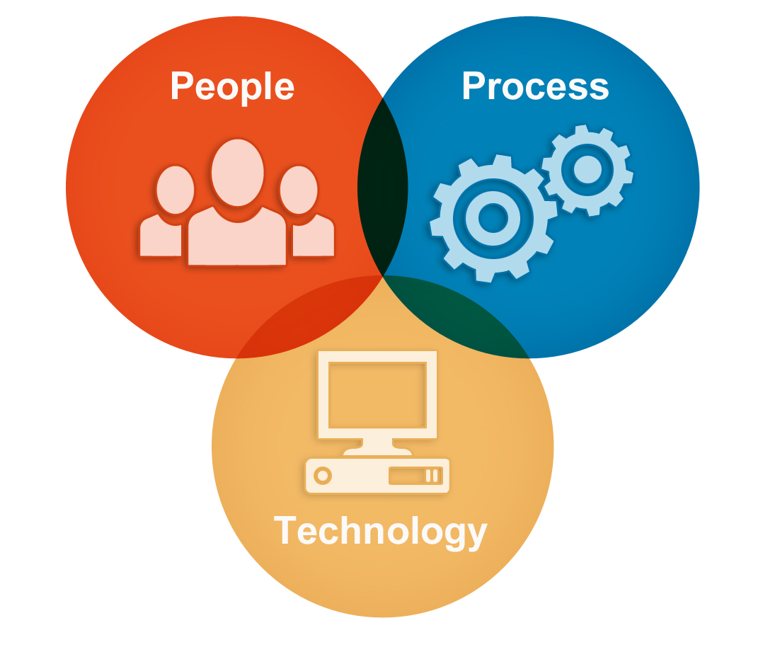
Notes:
Developing APIs (or any tech) in Government is an issue in Organizational Change Management.
Where you have align Process, Policy and People in order to enable Technology development.
It is daunting, slow and normally takes a lot of effort.

Slide 9

Notes:
However, there is hope on the horizon.

Slide 10
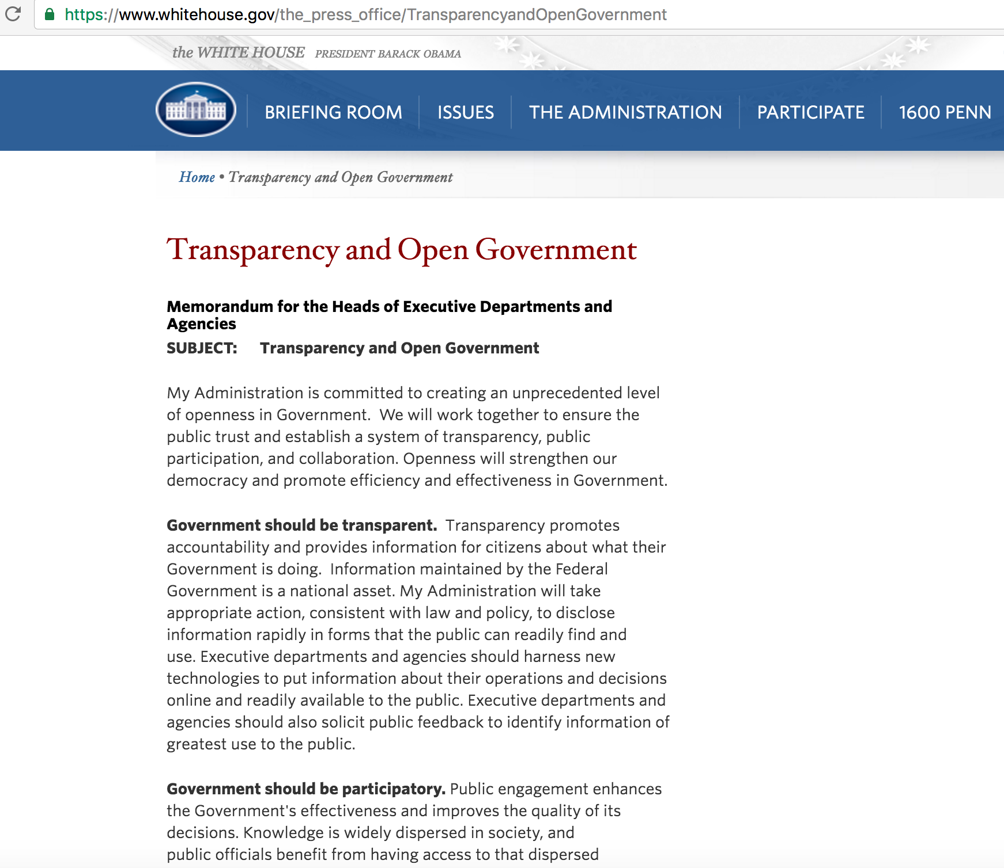
Executive Order M-13-13
Notes:
On May 9th 2013, the President created an Executive Order that stated that data produced by the US government should be machine-readable and open by default.
Executive Order -- Making Open and Machine Readable the New Default for Government Information

Slide 11
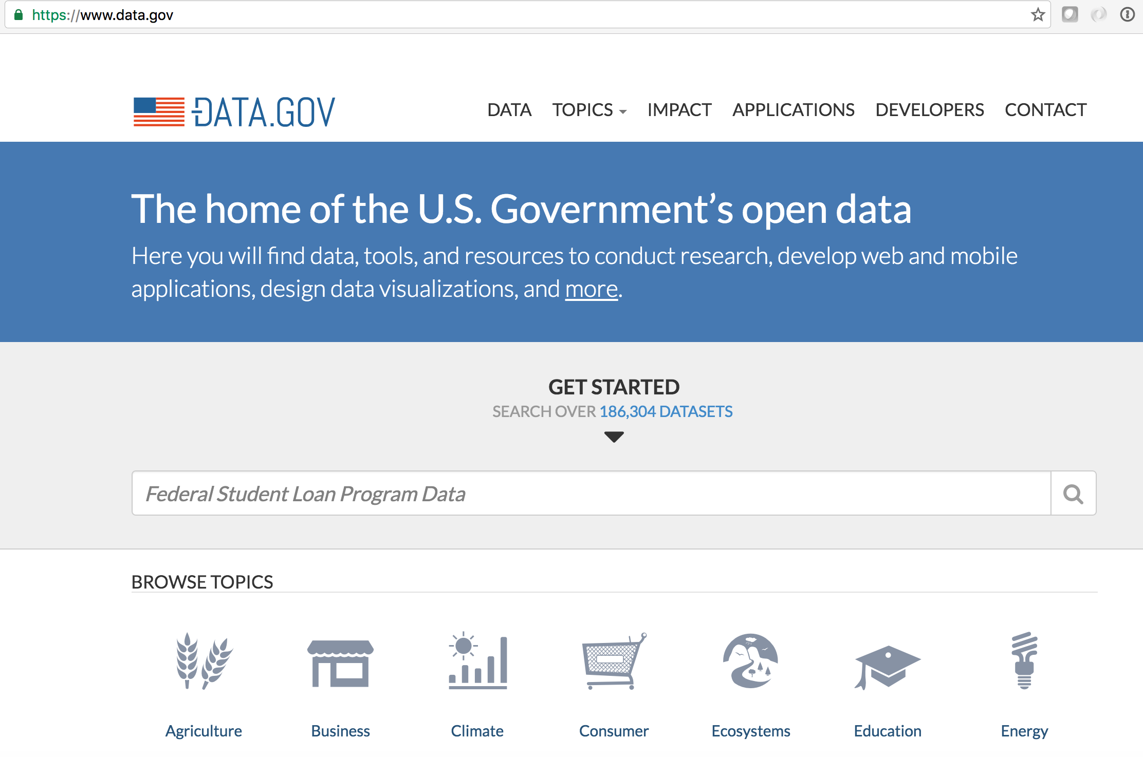
Notes:
Data.gov, which was launched in May 2009, was used as the vehicle or mechanism to fuel compliance to M-13-13 and offer a wealth of new data sets and APIs to the community.

Slide 12
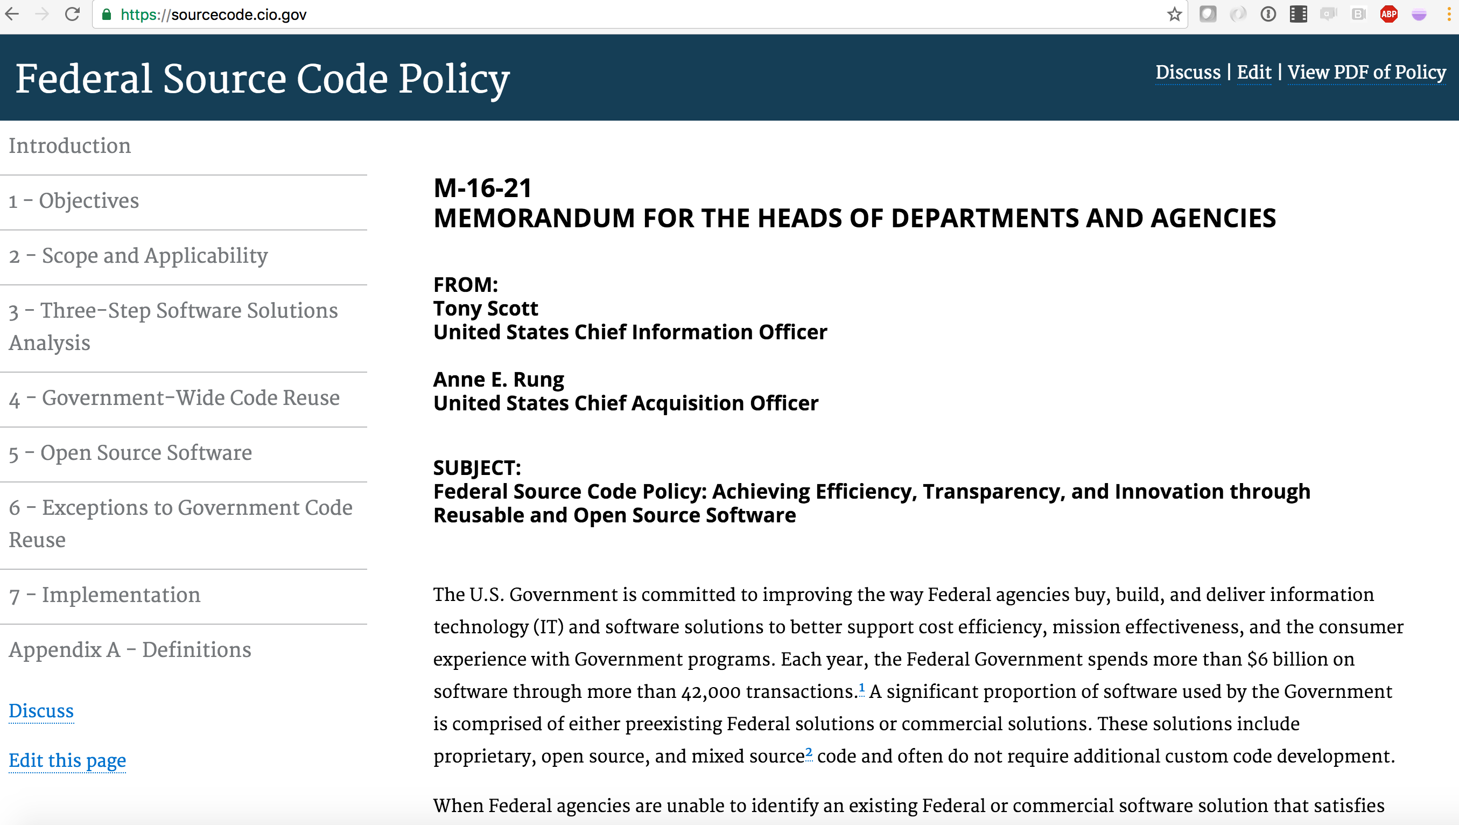
Notes:
Additionally, the Administration has just released the initial guidelines on Federal Source Code.

Slide 13

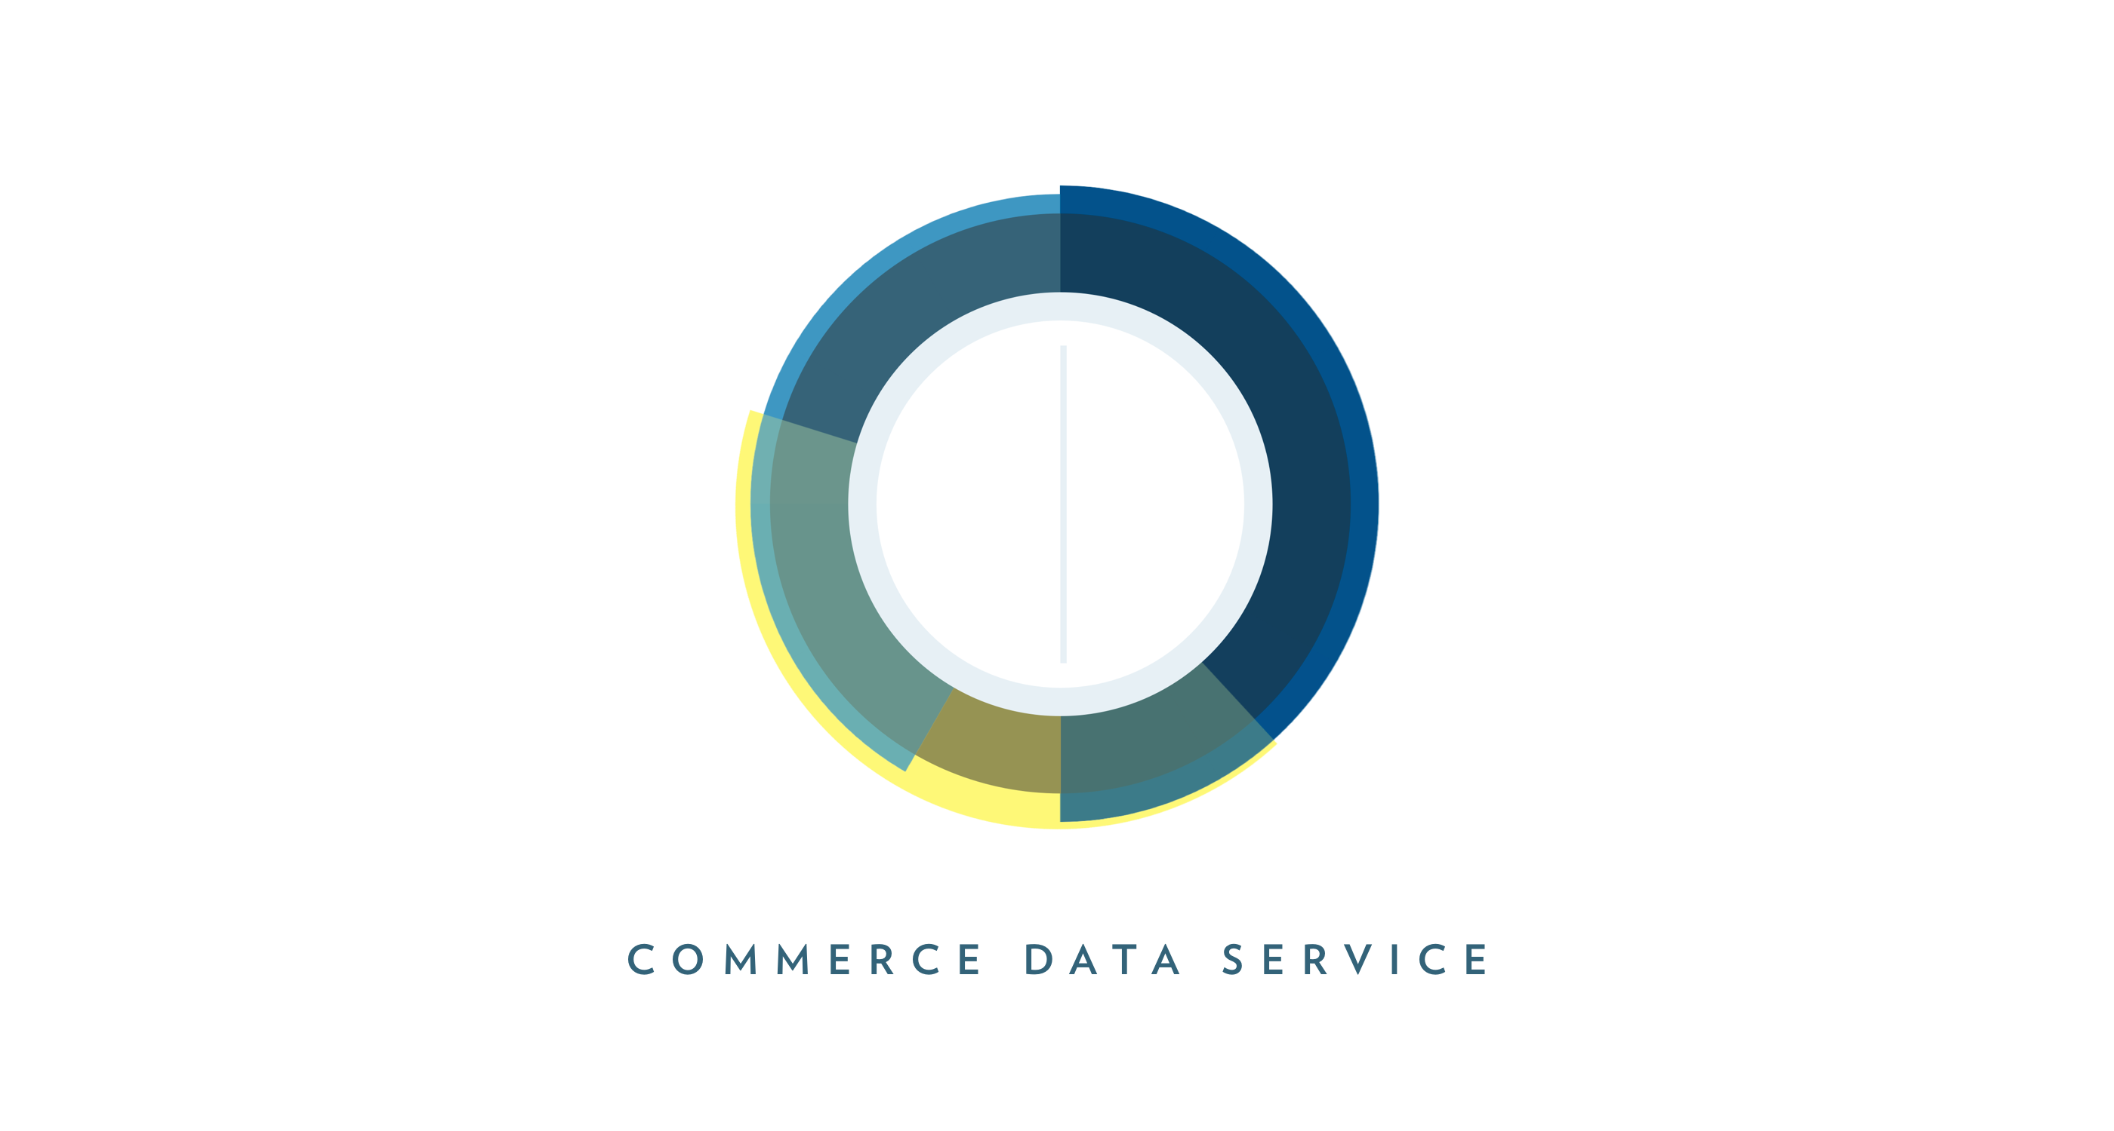


Notes:
You throw into the mix, an amazing set of agile and user-centered startup-like organizations within government working on accelerating the development of data products and services, and you see why there has been a steady stream of Social Good APIs coming from the Federal government over the last few years.

Slide 14
The Reality
APIs: Sweat and Toil, CitySDK, MIDAAS
Lessons
Notes:
Now, look at three APIs, focused on solving social problems, that my teams and I have developed and deployed within the last 15 months.

Slide 15
Sweat and Toil http://developer.dol.gov/others/sweat-and-toil https://github.com/USDepartmentofLabor/Child-Labor https://github.com/USDepartmentofLabor/Child-Labor-Android
Notes:
The first is Sweat and Toil. The API details are in the top URL. The API fuels both Android and iPhone apps with the same name. The other two URLS contain the code. If you have feedback and or want to collaborate, please let us know.
The data itself is the information produced by the Bureau of International Labor Affairs (ILAB) on the countries that produce goods and products that use child and or forced labor.
ILAB’s mission is to use all available international channels to 1) improve working conditions, 2) raise living standards, 3) protect workers' ability to exercise their rights, and 4) address the workplace exploitation of children and other vulnerable populations.

Slide 16

Notes:
Every year, ILAB has a congressional mandate to produce three reports on international child labor and forced labor.
Typically, the ILAB team spends nine months collecting information on all the countries in the world (except the US) to create over 1,000 pages of information that they then hand out in thick books; offering a PDF version on their website for increased accessibility.
Our idea was simple – liberate the data, make it available to the entire dev community and see what new and interesting things are done.

Slide 17

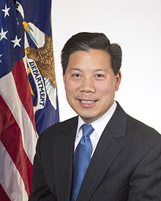
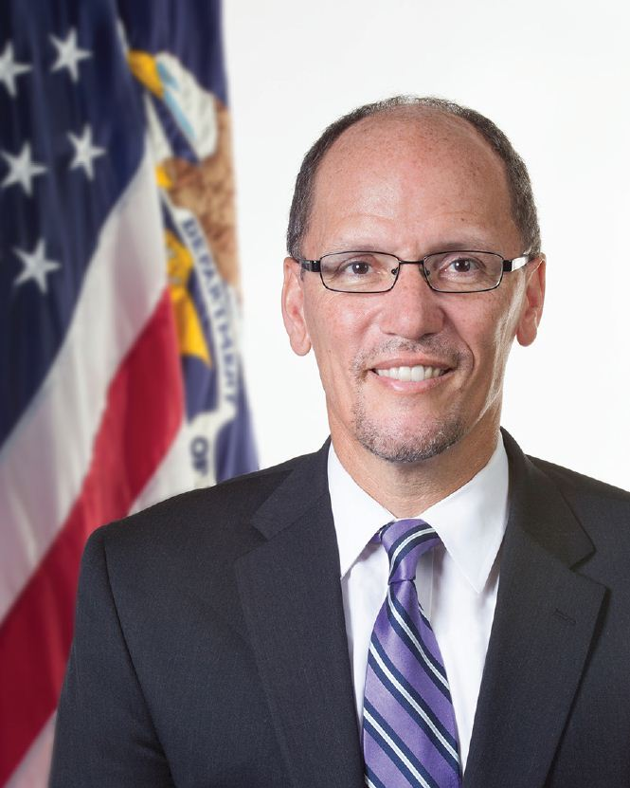
Building the API – Step 1
Coalition and Urgency
Notes:
The first step in making any API stick within the Department was getting the buy-in from the Department’s leadership.
Carol Pier – the head of ILAB and Chris Lu and Tom Perez – the leaders of the Department of Labor.
Without their support, getting the necessary assistance from the different units within the Department would have been impossible and we would have spent years in discussion on a plan of action.

Slide 18
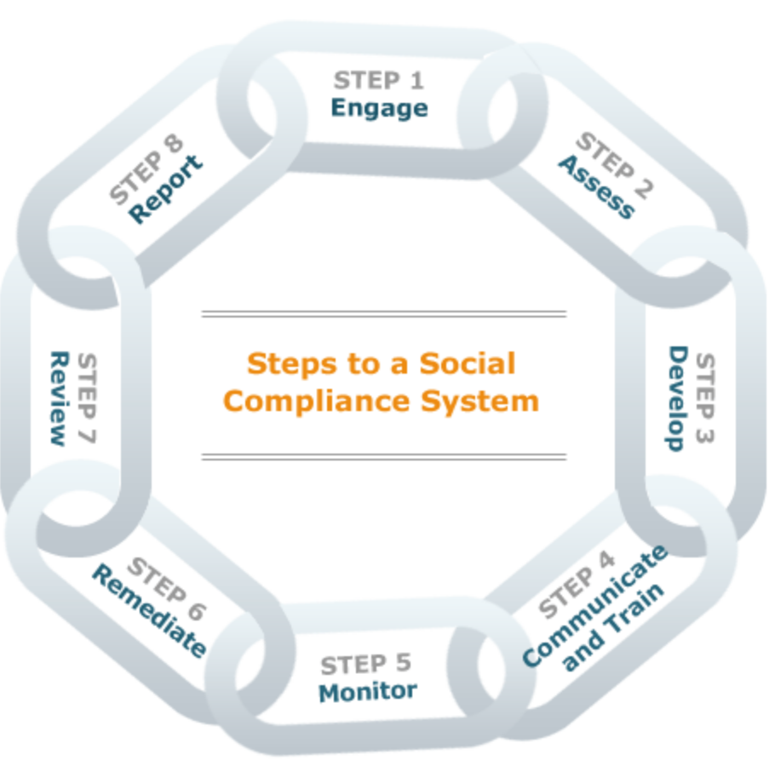
Building the API – Step 2
Understand The Data Production Process
Notes:
The second step was sitting with ILAB Program team (Tina Faulkner, Charita Castro, Chandra Ulca) and going through the process they use to create their thousand page deliverable.
In summary, there is a team of researchers that are tasked with manually gathering information from a set of countries in a given region. Each researcher records their findings in a single Word document per country. This document is passed around to peers and supervisors for vetting and editing until a final version is arrived at.
Once all the country profiles are complete, the Word documents are sent to a contractor to be converted to PDF documents and into HTML files. This PDF documents are merged and sent to a printing company that produces the books. The aggregate PDF document is placed on the website itself for download. The HTML files are used to populate the website.

Slide 19

Building the API – Step 3
Find Natural Intervention Point
Notes:
Given the current process, the first point when the data is in a stable state is when the Word docs are sent to the contractor for PDF conversion.
So, this is the point where we should start the API creation process.

Slide 20
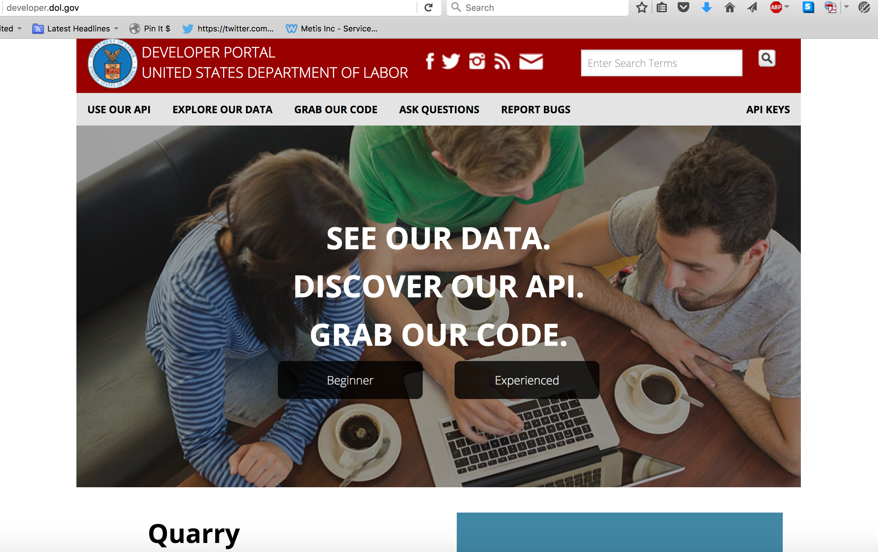
Building the API – Step 4
Learn Technology Constraints
Notes:
However, we just couldn’t use any technology that we wanted to build the API.
The Department of Labor’s Office of Public Affairs holds the responsibility for maintaining the Department’s APIs.
At the time, they have a v1 of their API and had embarked on a more full-featured v2 – which would handle API management for internal devs.
In order to ensure longevity, we had to use their platform, which is called Quarry – PHP, CodeIgniter – and currently open source.

Slide 21

Building the API – Step 5
Understand The API User Groups
Notes:
The ILAB team worked with us to identify the user personas for their data – politicians, researchers, internal ILAB staff & executives, government officials, and the general public.
For each user group, the team helped us identify and prioritize their user stories.
We used this as our starting point for defining our endpoints.

Slide 22
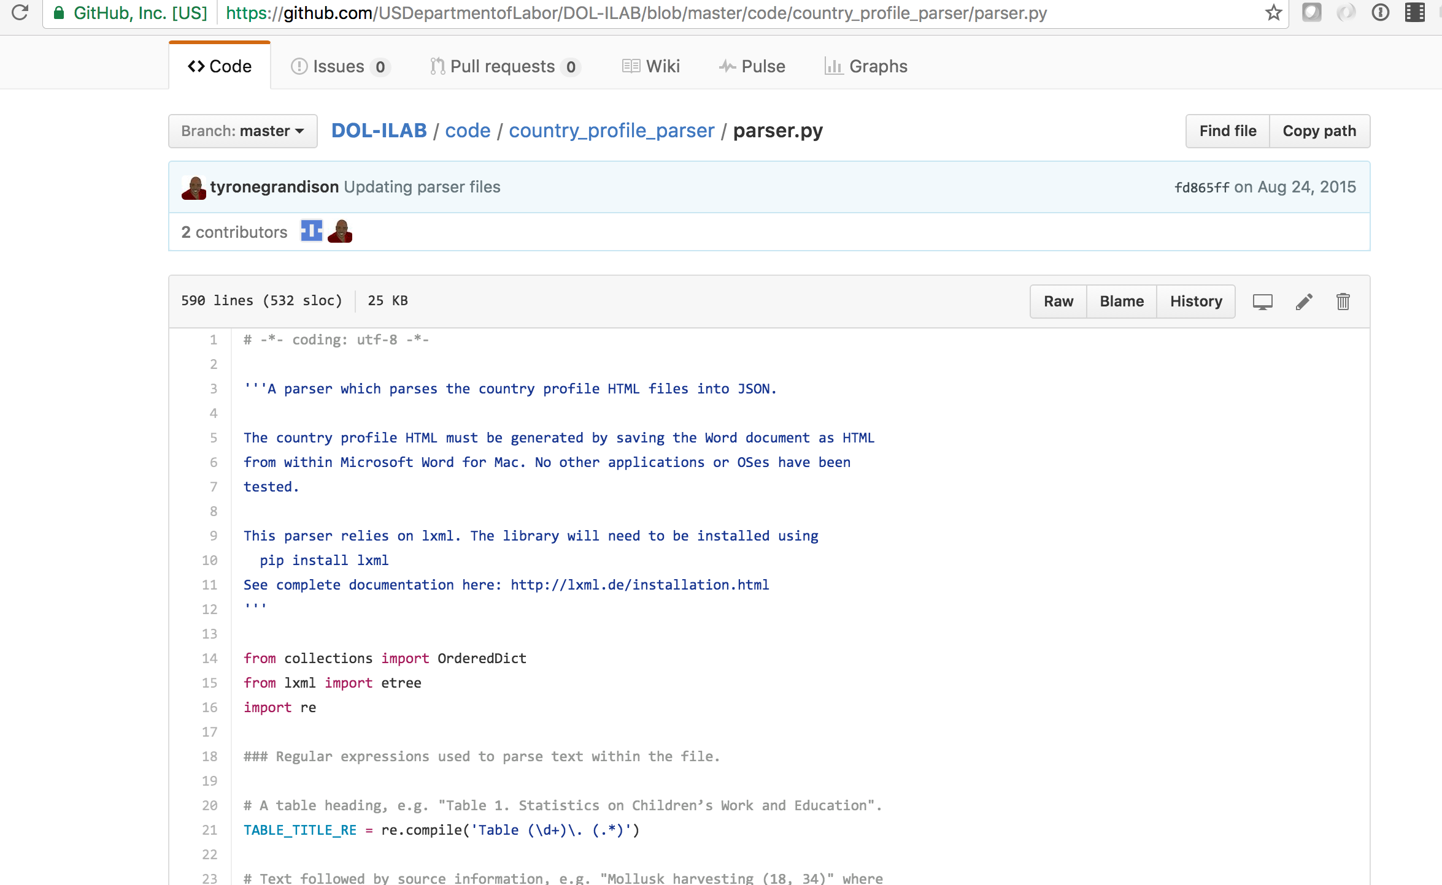
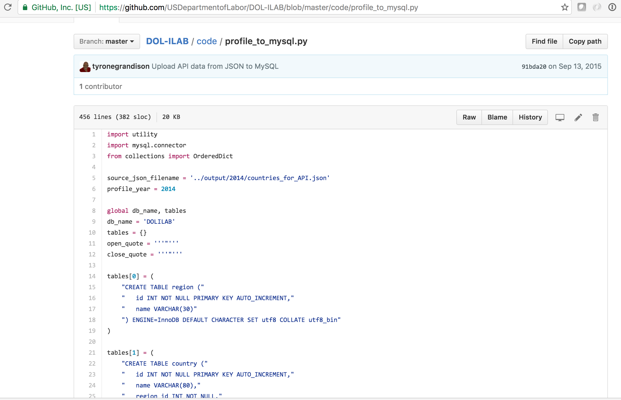
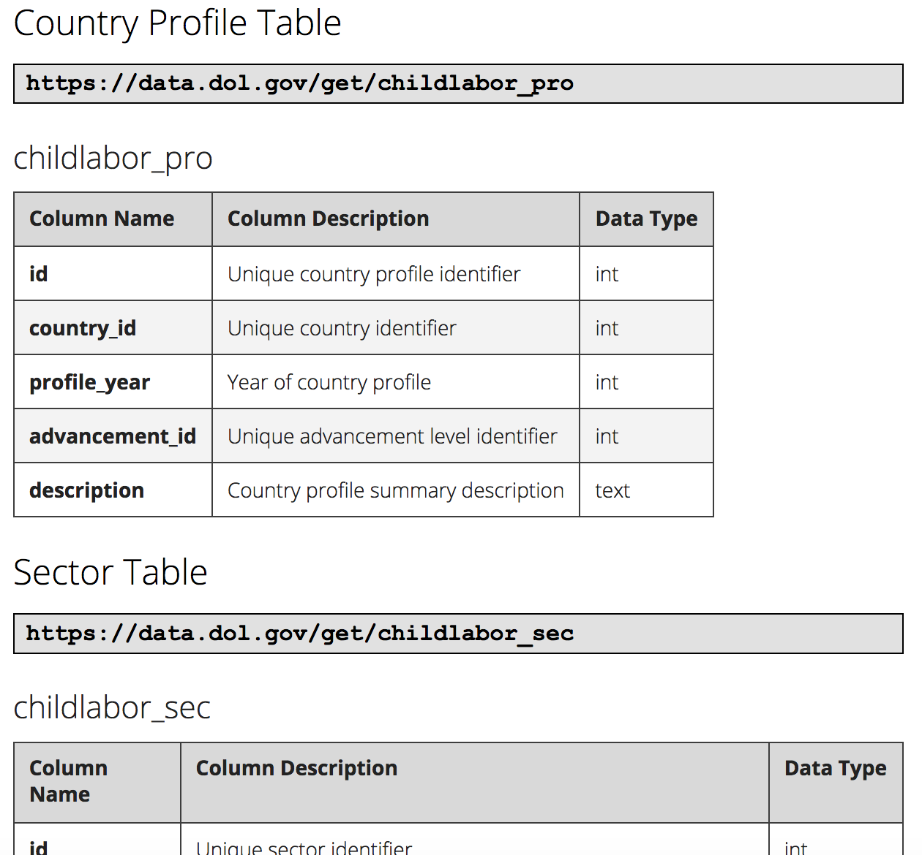
Building the API – Step 6
Python
MySQL, MSSQL
Quarry
Notes:
The final step involved using all the prior information to create a simple RESTful API.
Our process involves taking over a 150 Word documents and 5 spreadsheets and converting them into a single JSON file (with accompanying XML and CSV files).
Because Quarry expects the data to be served from a database, we have to create a separate script to export structure and context to a MySQL DB. Because of unicode issues, I also had to export to a MSSQL.
It is MSSQL that currently drives the API.

Slide 23
Census CitySDK https://uscensusbureau.github.io/citysdk/ https://github.com/uscensusbureau/citysdk
Notes:
The second API is “Census CitySDK”.
The first link is the URL for the project’s home; and the second is the project Github repo.

Slide 24
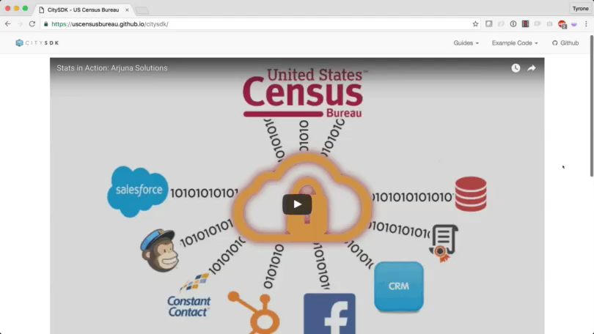
Notes:
CitySDK is a software development kit that enables the easy and seamless integration of Federal and local data sources in order of help civic innovators quickly build solutions to their local problems.
Though, we start with the data from the US Census Bureau, the intention is to expand the number of Federal agencies included in each release.

Slide 25
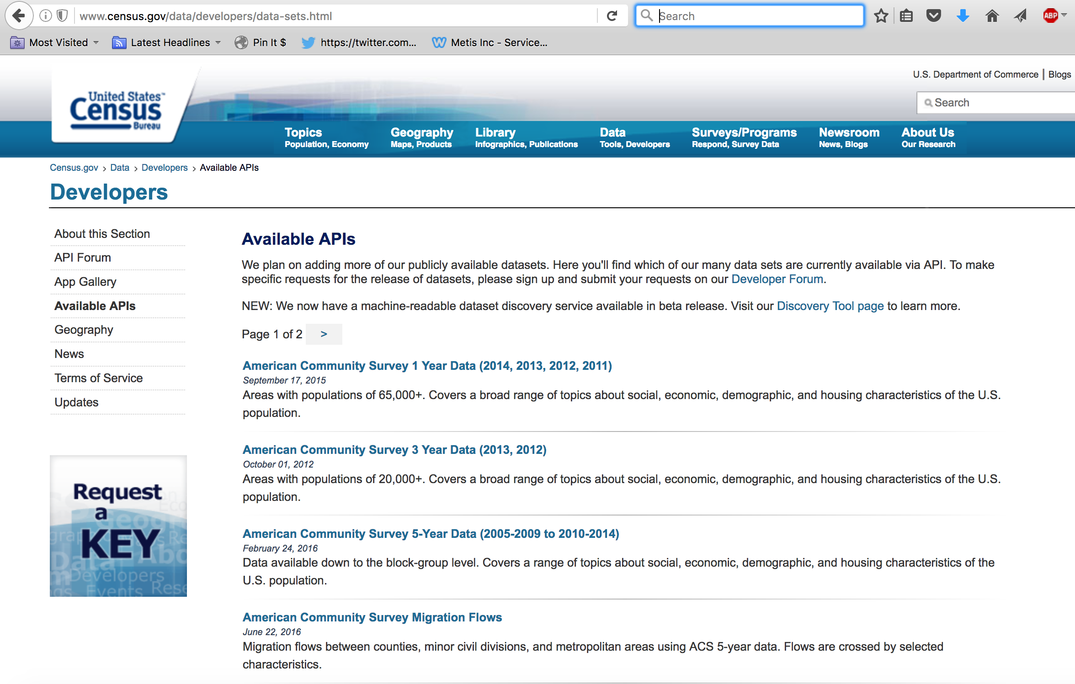
Building the API – Step 1
Validate The Demand
Notes:
The Census Bureau collects over 20,000 attributes on a representative sample of the 320 million people in American.
All the demographic studies that involve Americans and all solutions that include American geography use Census data.
Census has an API. However, most people prefer to perform bulk downloads rather than work with the Census API – because the simplest requests require multiple, non-intuitive steps.

Slide 26
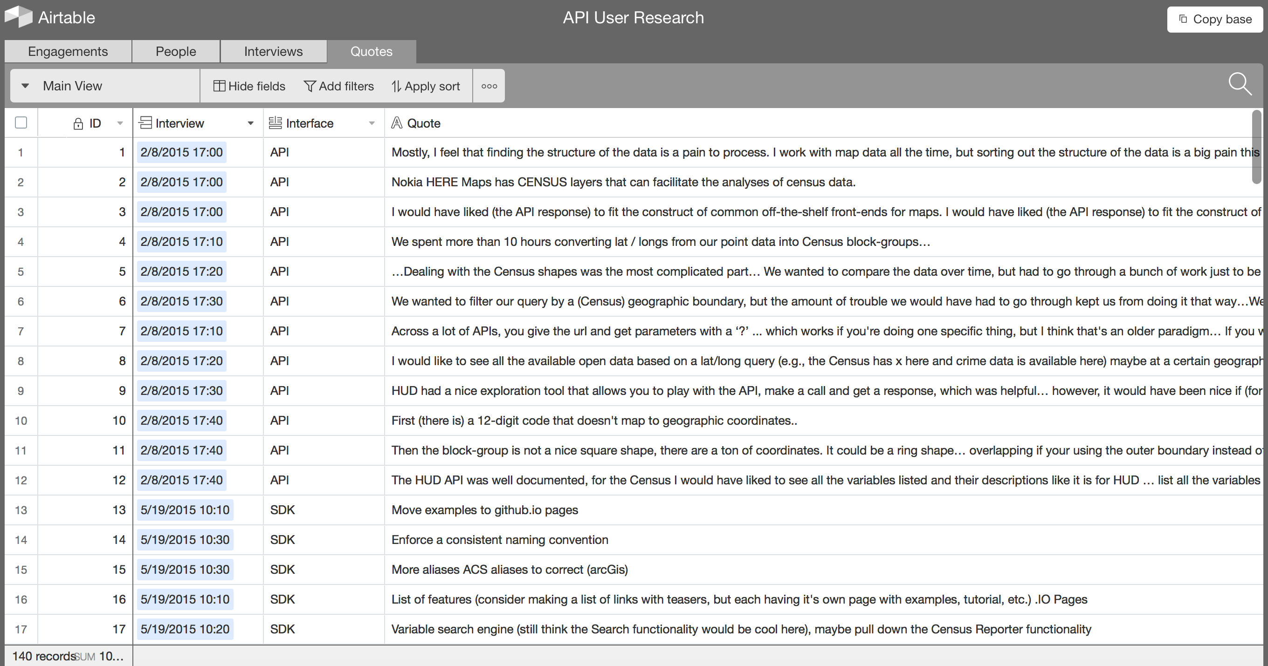
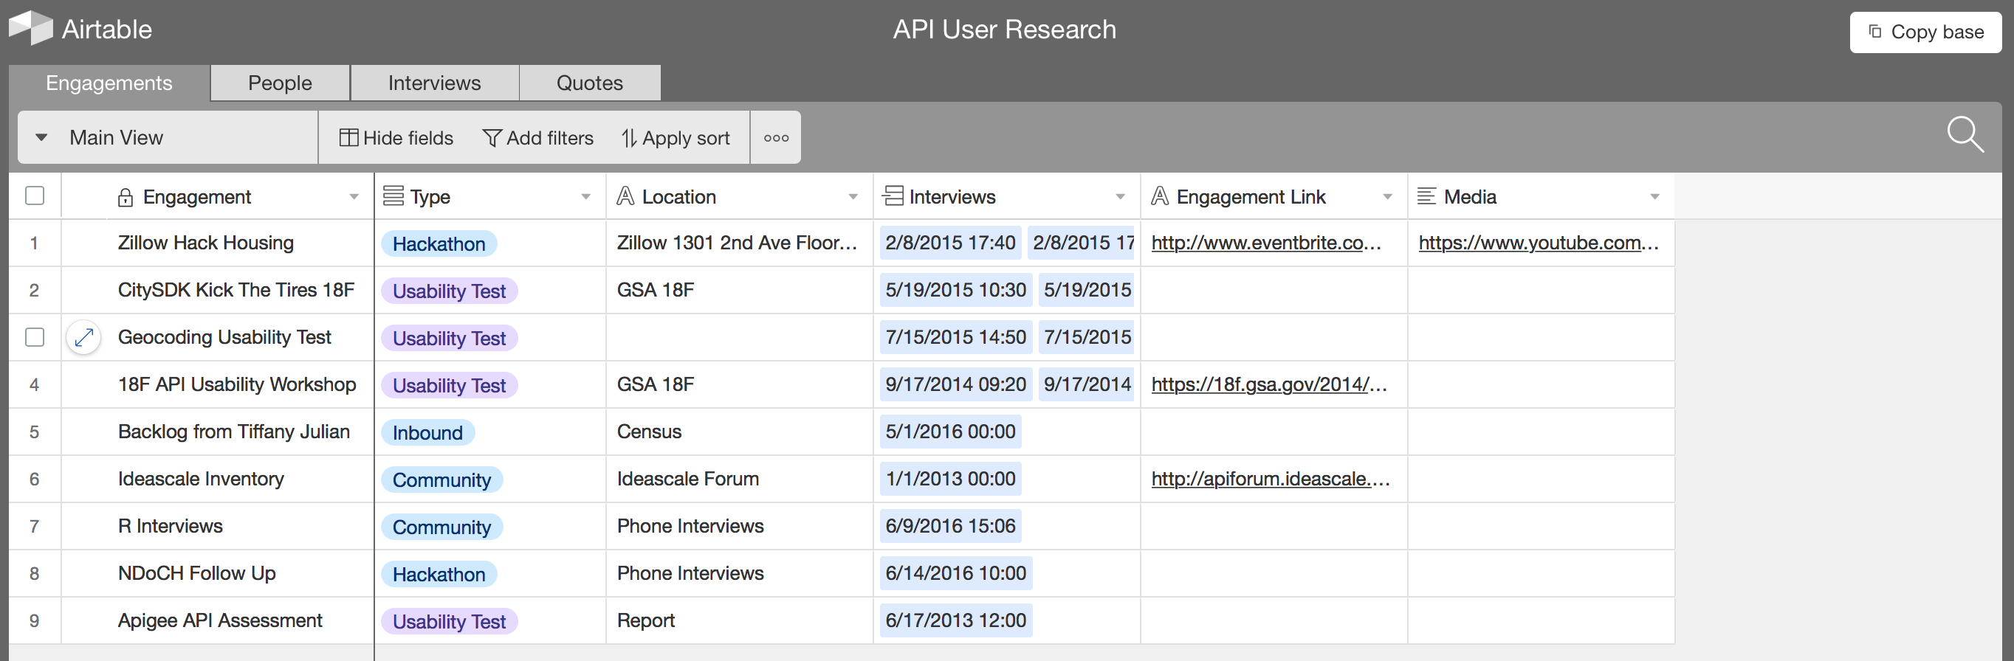
Building the API – Step 2
Understand The User
Notes:
To get to the specific issues that need to be fixed, we spoke to our users – the civic hackers.
We held a series of user discovery sessions and gathered the feedback from as many people as we could – legally.

Slide 27
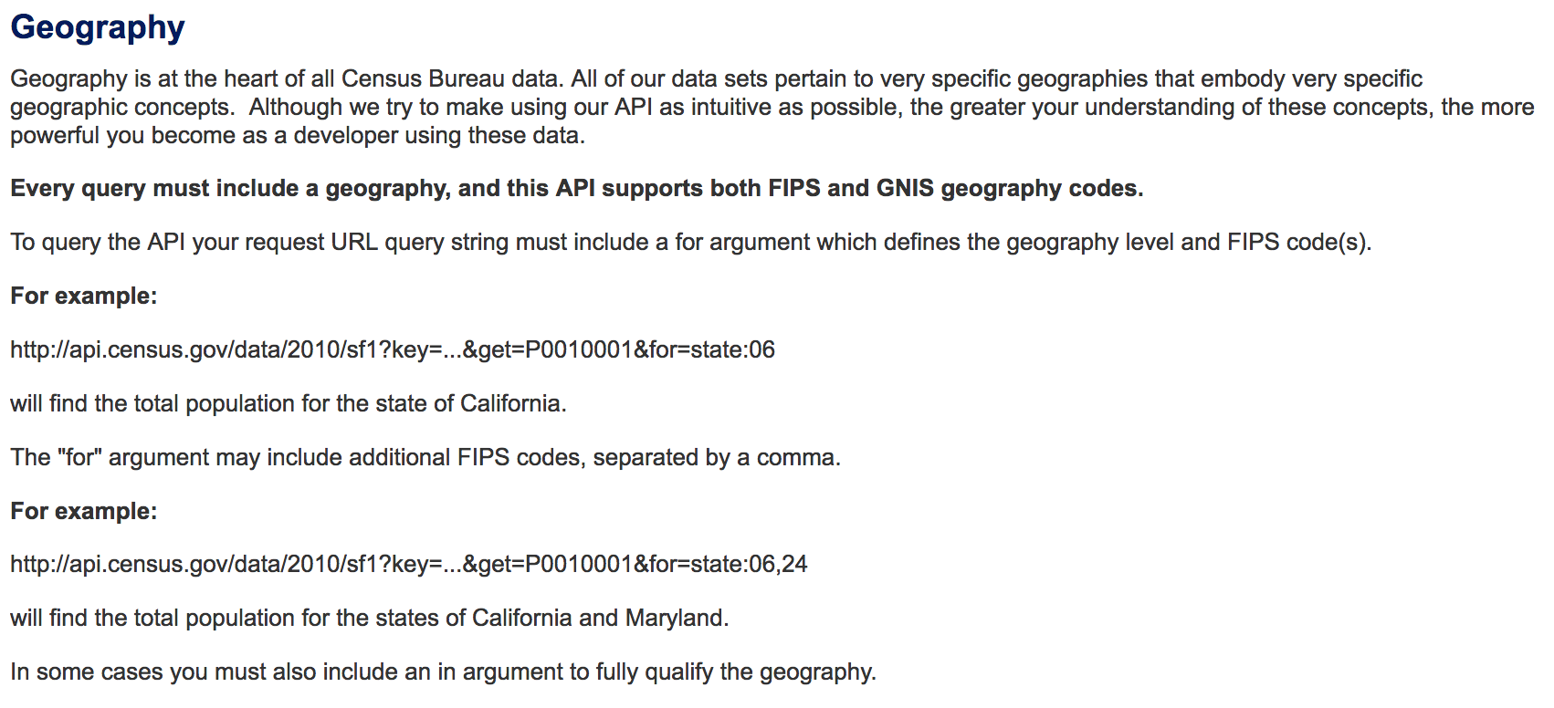
Building the API – Step 3
Understand Technology Constraints
Notes:
We were constrained by the fact that the Leadership team needed us to help with increasing usage of the Census API.
The IT team behind Census API would use the feedback received from our engagements to chart their path forward.

Slide 28
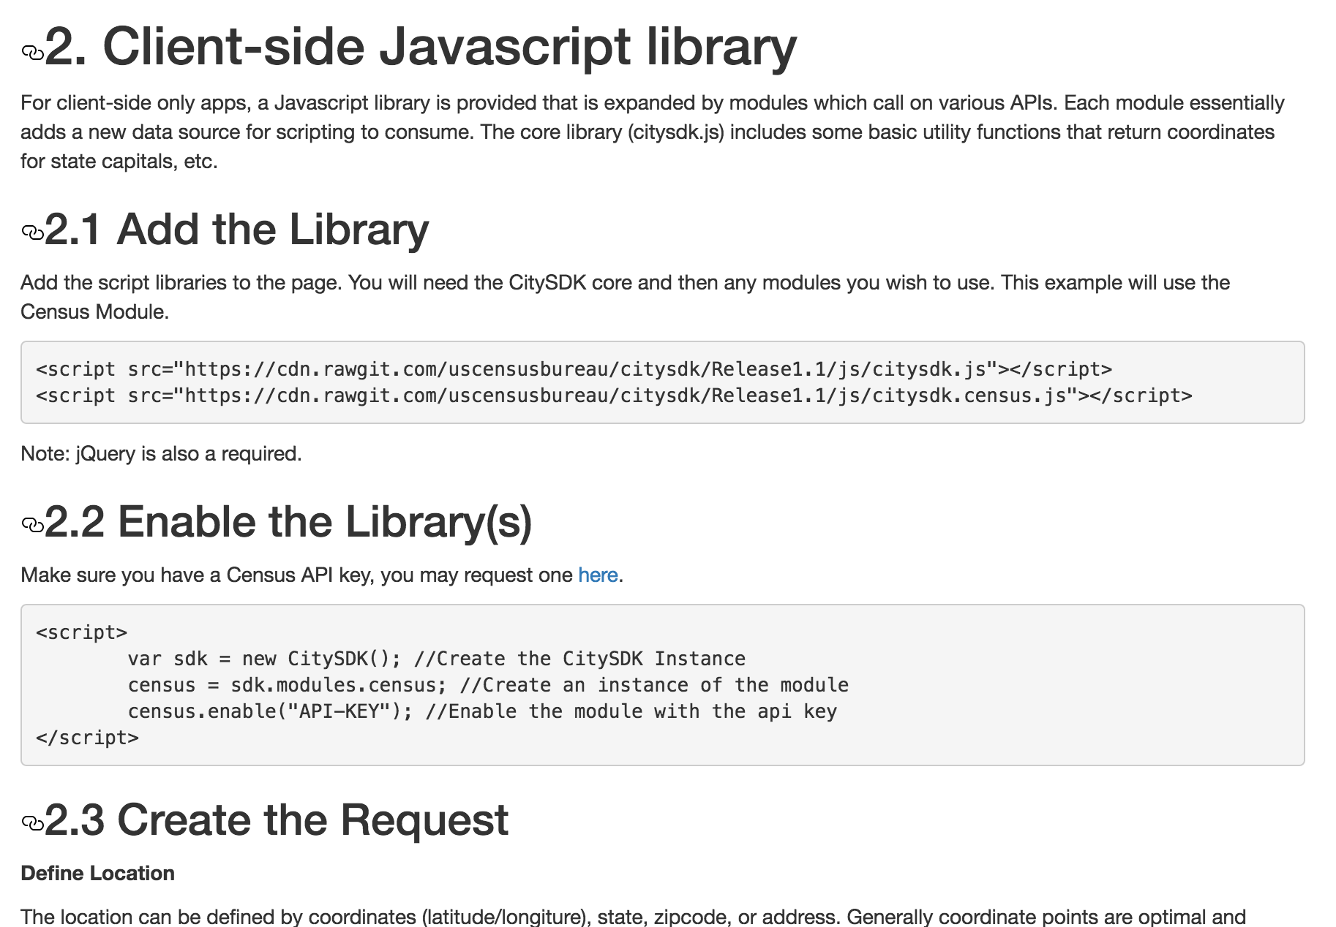
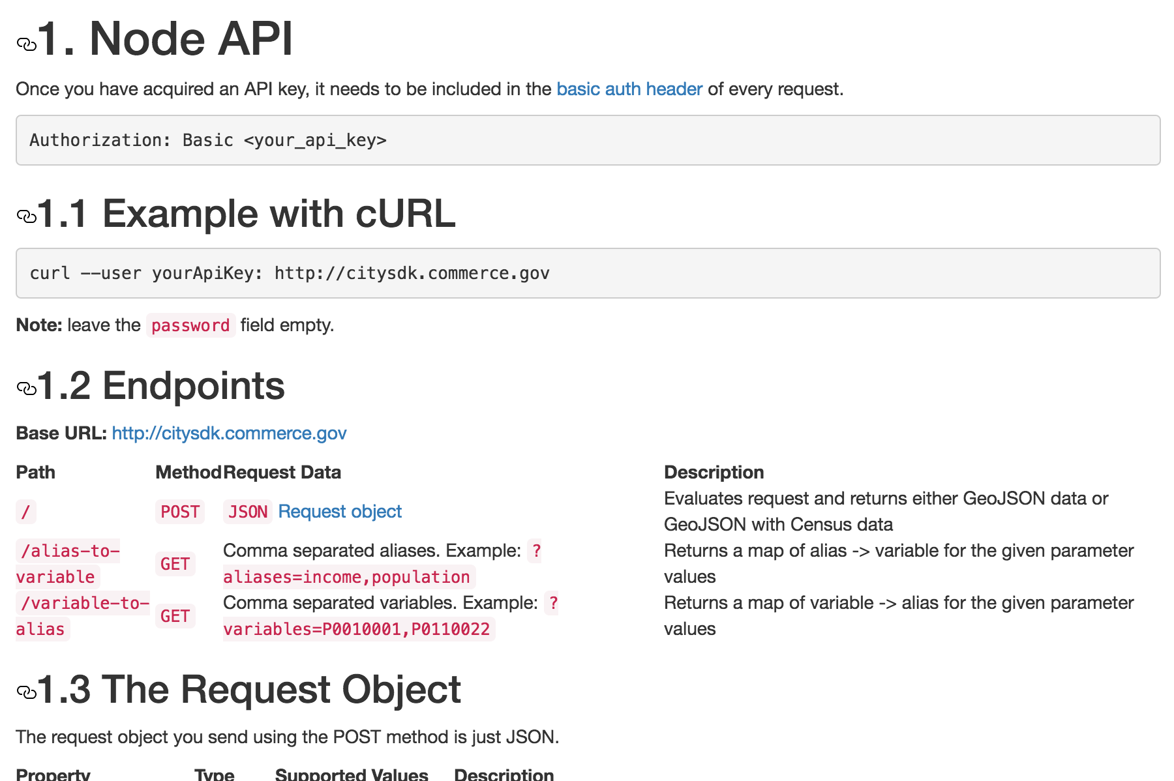
Building The API – Step 4
MVP
JS
beta
node.js
Notes:
For the Minimally Viable Product, we developed a thin layer that abstracted away the complexity of the Census API and allowed a JS developer to easily download Census attributes for any region and combine it with local datasets.
This was a decent start, but did not have the flexibility to be useful for developers that did not only want to visualize data.
So, we created a beta that can be used in any programming language. We implemented in using node.js and it enables richer data analysis scenarios.

Slide 29
MIDAAS https://midaas.commerce.gov https://github.com/CommerceDataService/midaas-api
Notes:
The third API is MIDAAS, which stands for Making Income Data Accessible As a Service.
The first link is the website that contains all the information on the project.
And the second link is the Github repo for the API.

Slide 30
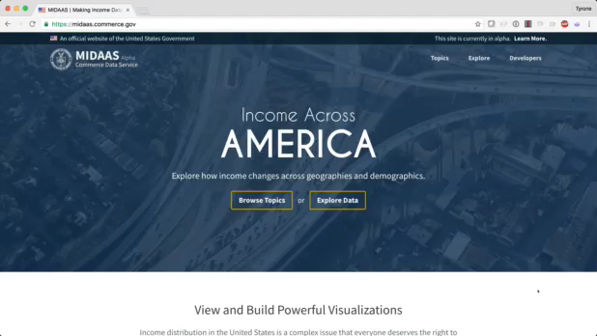
Notes:
This project focuses on Income Inequality – how do we have an informed discussion around income and wealth & enable the developer community to start building system based on income data from the Census Bureau and the Bureau of Labor Statistics.

Slide 31
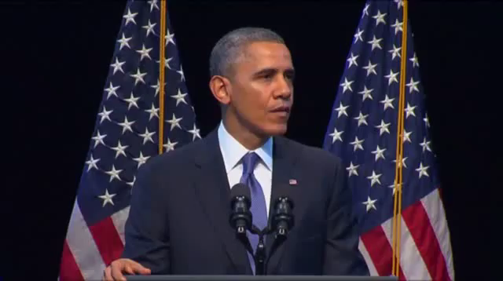
Building the API – Step 1
Validate The Need
Notes:
Income Inequality was defined by the President as one of the defining issues of our time.
…..
This is recognition we had to work on this initiative.

Slide 32

Building the API – Step 2
Understand Initial User Stories
Notes:
The Department of Commerce has a Data Advisory Board called CDAC – The Commerce Data Advisory Council - a group a high-level executives in the data space who echo’ed the President’s sentiment and provided the team with the initial user stories that we focused on.

Slide 33
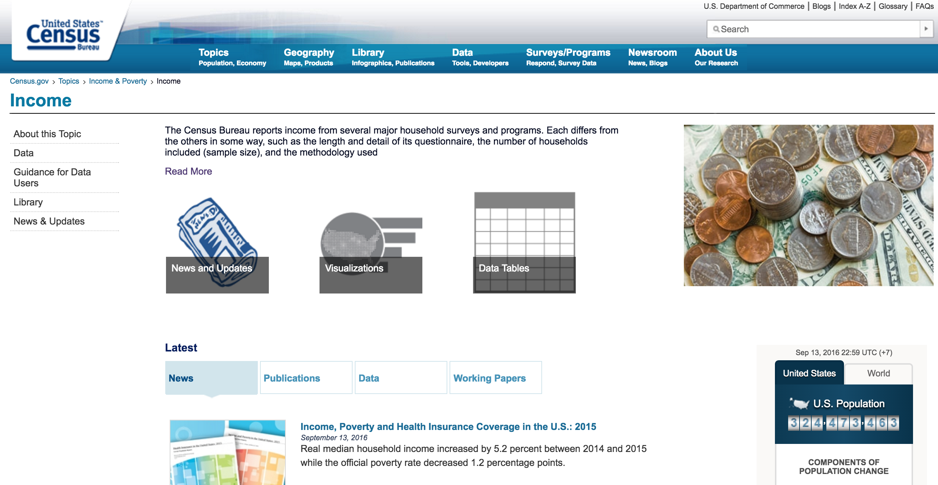
Building the API – Step 3
Validate with Domain Experts
Notes:
Fortunately, the Census Bureau has a deep bench of experts who have working in the Income and Wealth space for over three decades.
Trudi Renwick, who leads the Bureau’s Survey of Income and Program Participation, was kind enough to validate all things that we did with the data.

Slide 34
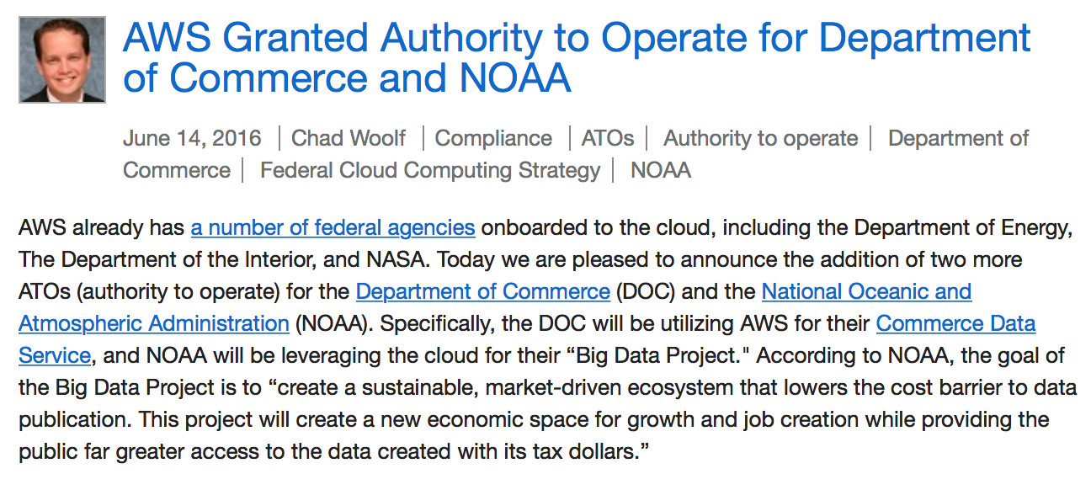
Building the API – Step 4
Understand Technical Constraints
Notes:
Fortunately, we were finally exploring getting formal approval to use the cloud within the Department.
The timing was right and the Commerce Data Service – a startup with the Department – could be the vehicle for externalizing this initiative.

Slide 35
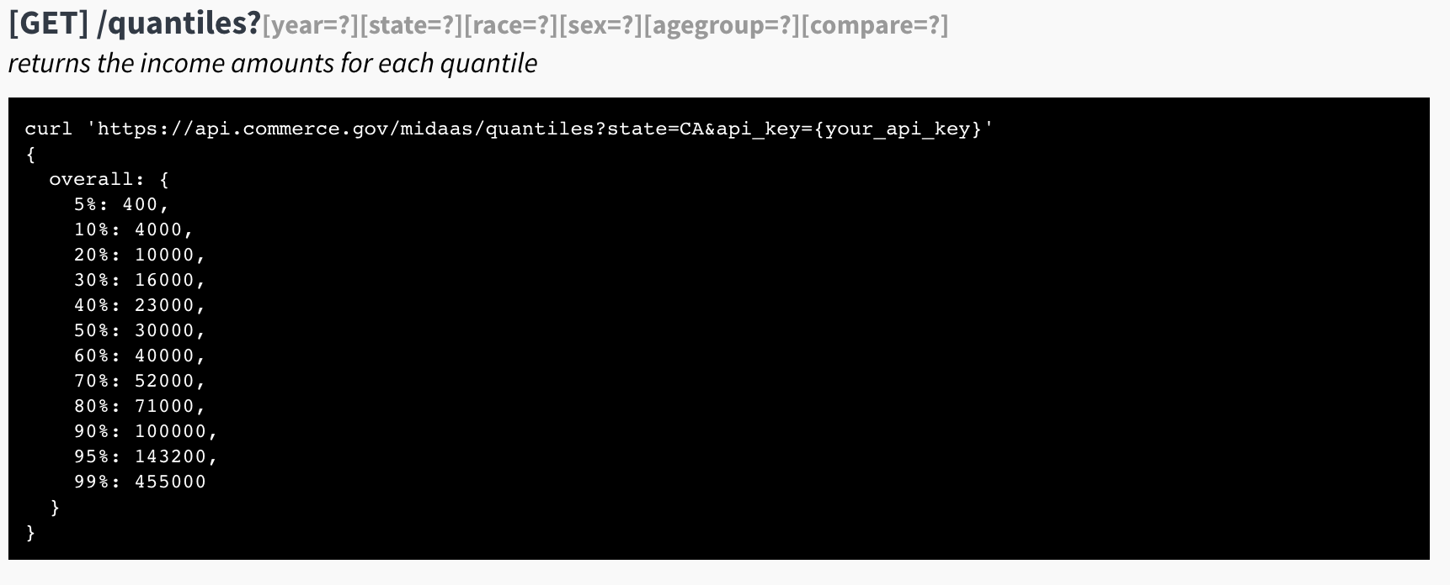
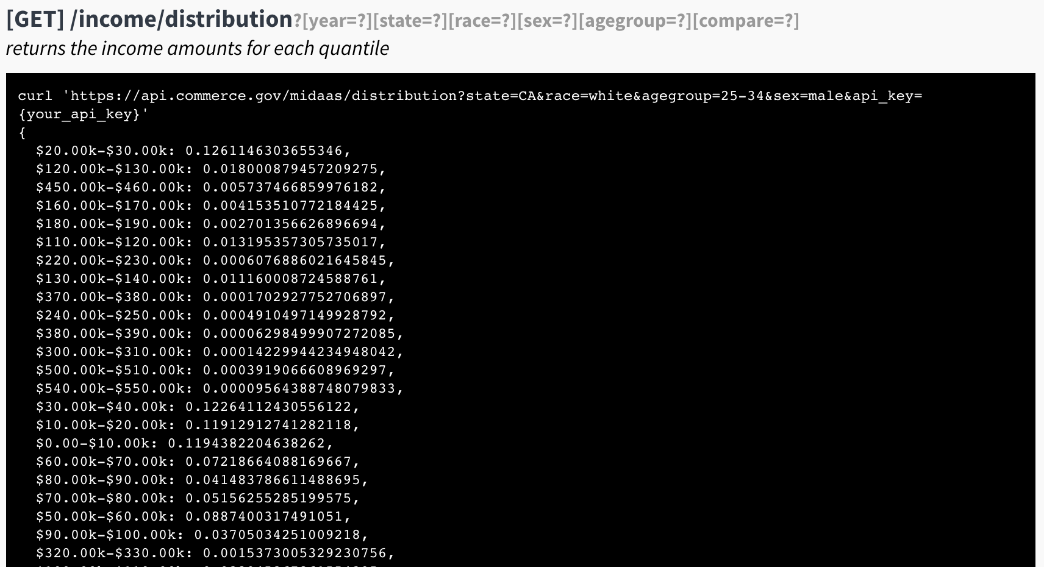
Building the API – Step 5
MVP
Redshift, Lambda, API Gateway
beta
Postgres, S3, EC2
Notes:
Both MVP and beta versions were built using AWS.
We took the ACS PUMS data, which is the most detailed (and most under-utilized) dataset produced by the US Census Bureau.
ACS stands for the American Community Survey and PUMS stands for the Public Microdata Use Sample.
We downloaded the full dataset, extracted the income and wealth dimensions and created an API specifically focused on accessing those dimensions.
For the MVP, we used Redshift, Lambda and API gateway. For the beta, we had to shift to an AWS stack that was FEDRAMP certified. So, we went to Postgres, S3 and EC2.

Slide 36
The Reality
APIs: Sweat and Toil, CitySDK, MIDAAS
Lessons
Notes:
Let’s look at what we learned from all this.

Slide 37
Summary
People
Scope
Constraints
Validate
Show The Thing
Notes:
It is important to have the support of leadership and the technology shop to both clear the way for these projects to happen and to ensure that these solutions persist.
It is extremely important that all projects are scoped for maximum awesomeness, which means that 1) they are focused, 2) they include user input, 3) that there must be a need for them, 4) that there should be access to both domain experts and end users, 5) there is a delivery path that fits naturally into an existing workflow.
Each of the APIs I presented used a different tech stack – because each had a different technical constraint.
Each solution was rigorously validated by the appropriate stakeholders because we need to make sure that we are appropriately using the data and that the data is high-quality.
Finally, we typically show our initial mockups or versions of what we are building in 2 to 4 weeks in order to start engaging our stakeholders.

Slide 38
So Far
Sweat and Toil
Monthly Data Users > Web Traffic
Three tools built using this data.
CENSUS CitySDK
Over 10 civic solutions built using CitySDK
Positive User Feedback
MIDAAS: Hack The Pay Gap Initiative
Notes:
Sweat and Toil: The monthly access stats for the data now triples the ILAB web traffic. We have taken the API to a few hackathons and a few teams have built interesting apps on the data.
CitySDK: In Minnesota, civil hackers built a CitySDK app that helps people with disabilities easily find a place to live or travel to in the state that satisfies their specific accessibility needs.
In Chicago, innovators created Purshable - a CitySDK mobile app helps reduce waste, increase grocer’s profit, and offer shoppers high quality food at a fraction of the cost.
In Washington DC, technologists developed HyperLocal - a CitySDK app that helps Food Truck operators without a lottery parking spot find customers by locating tweets from those who are hungry.
MIDAAS: Was used to launched the Hack The Pay Gap project.

Slide 39
So Far
Sweat and Toil
2016 Department of Labor‘s Innovation Award.
MIDAAS
2016 Nominee Fedscoop Innovation Of The Year.
CENSUS CitySDK
2016 Department of Commerce Gold medal
2016 Best Data API Award, API:World
2015 Fedscoop Innovation Of The Year
Notes:
We have been fortunate enough to have caught the eye of a few organizations that have honored the team’s work.
…....

Slide 40
Thank you
tyronewagrandison@gmail.com
Notes:
I will end with that.
Any questions?

